Slide 1
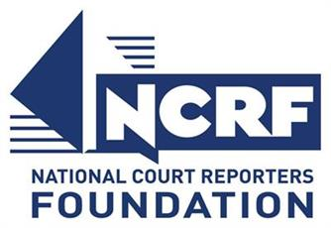

Remembering my dad through the Veterans History Project
By Marjorie Peters
I think it all starts with my father. My dad, Art Peters, was born in 1923 in a farm in rural Pennsylvania. His parents were a schoolteacher and a mechanic on the Bessemer railroad, but they also had a working vegetable farm and, of course, animals for food. His grandparents had dairy.

Slide 2
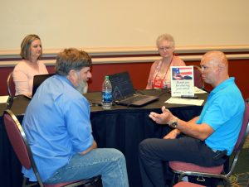
Retired Staff Sgt. Shilo Harris (front right), who received life threatening injuries while serving in Iraq, is interviewed by retired Lt. Lynn Hinckley (front left). Cecilee G. Wilson (back right) provides CART while Amber Fraass (back left) transcribes.
NCRF hosts a second Hard-of-Hearing Heroes Veterans History Project
The National Court Reporters Foundation hosted a second Hard-of-Hearing Heroes Project initiative on June 23 at the 2017 Hearing Loss Association of America (HLAA) Convention held in Salt Lake City, Utah. Volunteer court reporters, captioners, and interviewers turned out to help chronicle the service experiences of seven veterans, which will be transcribed for the U.S. Library of Congress Veterans History Project (VHP).

Slide 3

The Library of Congress Veterans History Projects is one of NCRF’s most popular oral histories programs. It connects stenographic reporters to American history. NCRA members have helped preserve history by transcribing pre-recorded interviews, as well as live testimonials from American veterans.

Slide 4
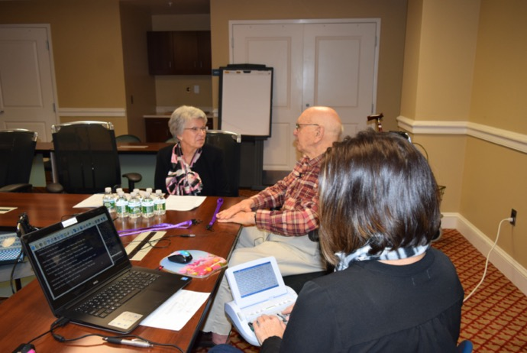
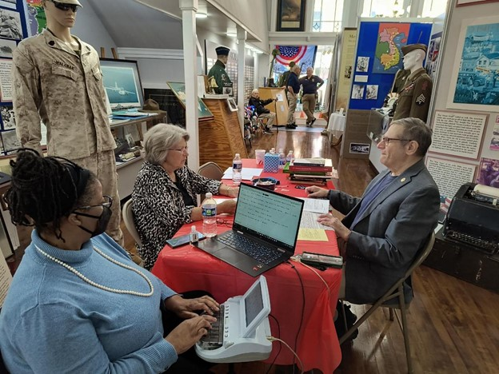
NCRF & the VHP
  Veterans History Project
  Nearly 5,000 transcripts completed!

Slide 5
NCRF & the VHP
NCRF’s Purple Heart Veterans History Project earns top honors
NCRF’s efforts to commemorate National Purple Heart Day by hosting a Veterans History Project event during the 2016 NCRA Convention & Expo held in Chicago, Ill., have earned top honors in the Golden Image Awards sponsored by the Florida Public Relations Association’s (FPRA) Capital Chapter.
Firm owners honor veterans through the Veterans History Project
In honor of Veterans Day, court reporting firms across the nation gathered to interview veterans about their wartime experiences as part of NCRF’s partnership with the Library of Congress Veterans History Project (VHP).

Slide 6
NCRF & the VHP
Gold Star families added to Library of Congress Veterans History Project
NJ.com reported on Nov. 16 that the U.S. Senate has approved legislation that adds Gold Star families to the Library of Congress Veterans History Project.…
Ohio veterans tell their stories for oral history project
NCRA member Kelly Linkowski, RPR, CCR, CRC, CPE, was interviewed in a story posted by radio station WOSU for National Public Radio on Jan. 17…
Lake County veterans share experiences at annual oral history project
The Lake County News-Sun posted an article on Nov. 13 about the sixth annual Veterans History Project held at the Lake County Courthouse, Ill. NCRA…

Slide 7
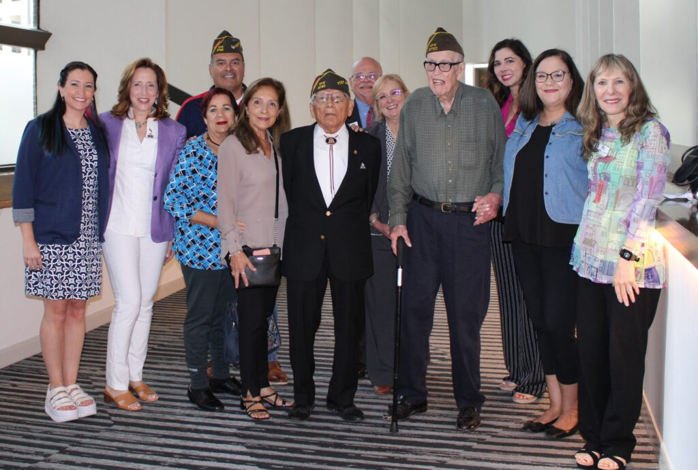
NCRF & the VHP
Court reporters preserve veterans’ stories for the Library of Congress

Slide 8
Veterans share war stories, insight to service at event hosted by NCRF in Houston
Capturing and transcribing stories from veterans not only helps to preserve their memory, but also serves to shed light on the…
VHP testimony makes History Channel Black WWII documentary possible
Since 2001 NCRA members have volunteered for the Library of Congress Veterans History Project. CBS aired a segment on Sunday Morning about Morgan Freeman’s upcoming…
VHP event honors Vietnam veterans
In honor of Vietnam Veterans Day observed March 29, the oral histories of seven military members were written for the Veterans History Project (VHP), part…

