Slide 1
Customizable text area
© 2023 National Court Reporters Association

Slide 2

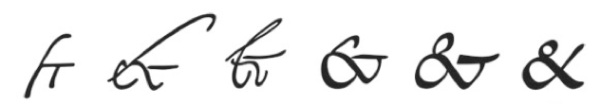
Did you know?
  The profession dates back to the 4th century B.C.E.
  Throughout history, court reporters have served the public by making accurate records of critical events.
  The ampersand symbol (&) that we use today is one of the earliest forms of shorthand.

Slide 3
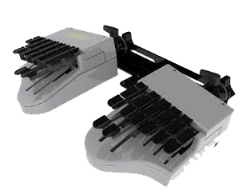
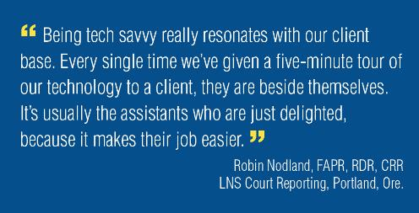
Today’s court reporters and captioners
are on the cutting edge of technology,
driving advances in translating the
spoken word to print.

Slide 4

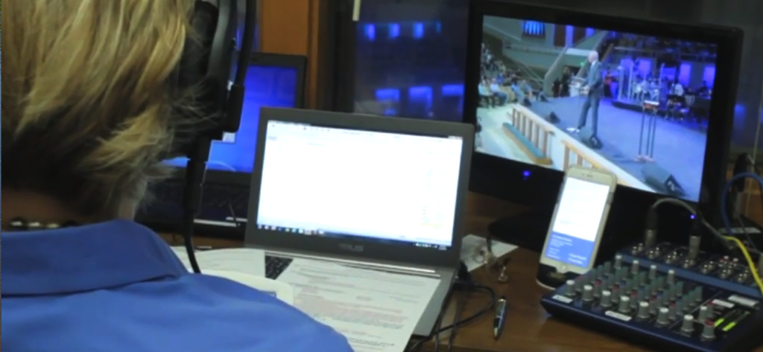
People who successfully train to become court reporters and captioners have numerous career options, including these well-known fields:
  Freelance reporting
  Courtroom reporting
  Captioning – live and remote

Slide 5
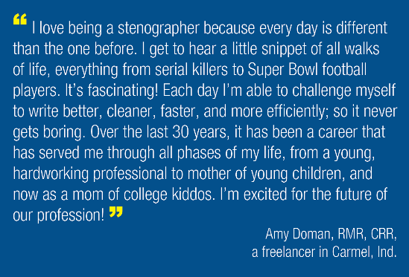
Freelancers are hired by:
  Attorneys
  Corporations
  Unions
  Associations
  Contractors
  Entrepreneurs
  and more!

Slide 6
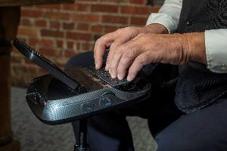
Provide records of meetings and hearings for:
  Pretrial depositions
  Arbitrations
  Board meetings
  Stockholder meetings
  Convention sessions
  Other business sessions and more!
Make your
own schedule
Using modern technology, many freelancers conduct realtime assignments from their home offices.

Slide 7
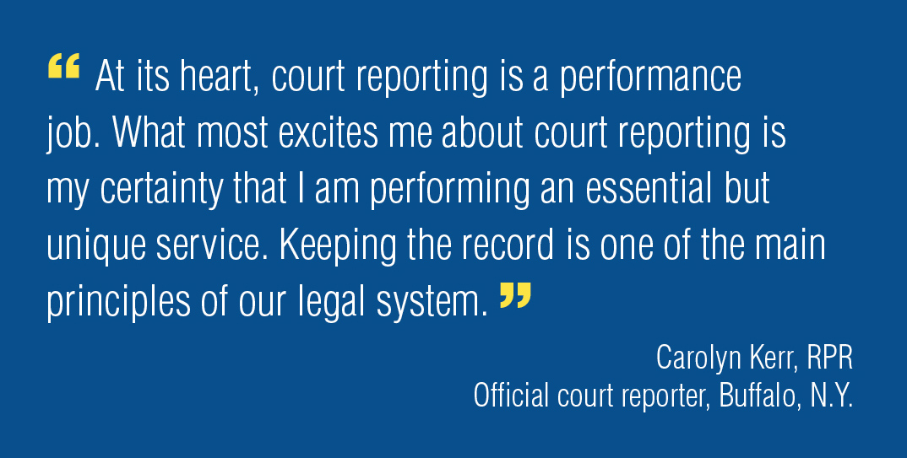
Courtroom or official reporters find employment from:
Local, state, and federal governments
  Often as part of the team serving one judge or courtroom
  Compensated on a government pay scale
  Earn government benefits
Firm owners and private industry employers
  Provide services in
  court and in other
  business settings
  Meetings
  Conventions
  Board meetings
  Arbitrations and more!

Slide 8
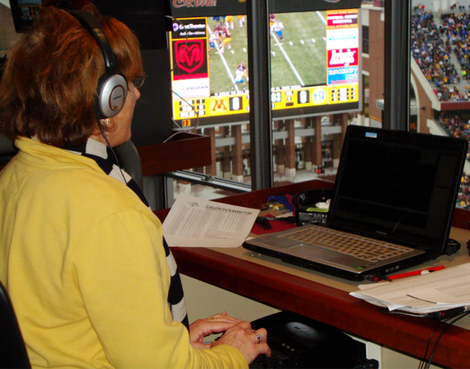
Broadcast captioners:
  Provide critical information during emergencies to millions of Americans who are deaf or hard of hearing.
  Enable viewers who are not native English speakers to enjoy news, sports, and entertainment programming.
  Take advantage of a strong job market.
Flexible
hours
and work environments

Slide 9
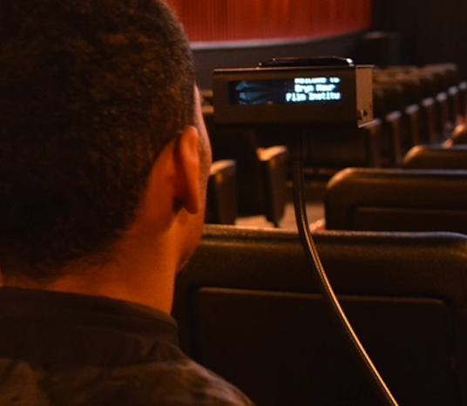
Communication Access Realtime Translation (CART) captioners:
  Enable universal access for speeches, lectures, and proceedings to individuals.
  Work in interesting environments from the classroom to the boardroom.
Get certified and expand your options

Slide 10

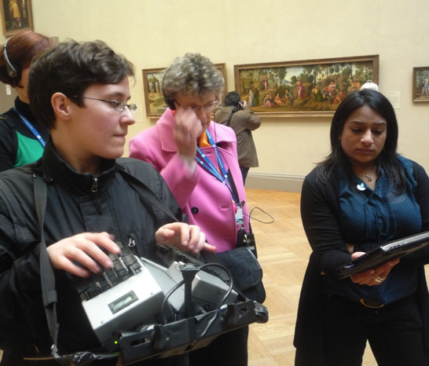
Other captioning venues:
  Financial earnings calls
  Sales meetings
  Press conferences
  Product introductions
  Technical training seminars

Slide 11
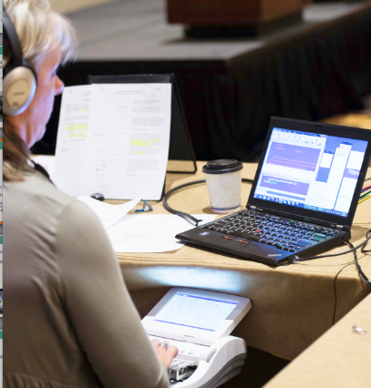
Court reporters and captioners use
realtime technology to enhance the
marketability of their skills.
Three-step process:
  The reporter’s steno machine
  connects to a computer.
  Software translates the
  shorthand to full text.
  Clients receive the feed on
  their electronic devices seconds
  after the words are spoken.

Slide 12
Court reporters and captioners with certification can expect the best job opportunities.
Demand for court reporters and captioners is currently on the rise.
Opportunities are nationwide.

Slide 13
Court reporting and captioning are often overlooked as top jobs for professionals, especially as a career that doesn’t require a
four-year college degree.
The truth is, court reporters can spend less time in school and be on their way to earning a
salary that is competitive with other professions
requiring four-year degrees.

Slide 14
Court reporting and captioning are careers that will be in increasingly high demand well into the future.
The average age of our current court reporters is 51. About 70 percent of existing court reporters will retire in the next 20 years.
There are ample job opportunities nationwide.

Slide 15



The profession is a
great choice for:
  Graduating high school
  students
  Career changers
  College path redirects
  Veterans

Slide 16

What it takes:
  Strong vocabulary and a good ear for accents
  and dialects.
  Ability to think on your feet and adapt to a variety of situations.
  Able to focus 100 percent on the task at hand.

Slide 17


Where to start:
To learn more
about this exciting profession, visit DiscoverSteno.org.

Slide 18
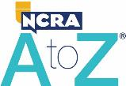
Interested?
Attend a FREE online
NCRA A to Z Intro to Steno Machine
Shorthand program
The NCRA A to Z® Intro to Steno Machine Shorthand program offers the perfect opportunity for potential students to learn the alphabet in steno, write on a real machine, and decide if pursuing an education in court reporting or captioning is the right choice.
  The free six-to-eight-week program teaches the basics of steno writing.
  Programs can be online, in-person, or asynchronous.
  Students can use a real steno machine or download the iStenoPad app.
  The schedule of upcoming programs can be found at NCRA.org/AtoZonline.
Sign up for a free NCRA A to Z Intro to Steno Machine Shorthand program today.

Slide 19

Review PowerPoint later
If you would like to review the information in this PowerPoint again, scan the QR code to download a copy.

Slide 20

Customize here
For more about the opportunities available in the court reporting and captioning professions,
^{visit DiscoverSteno.org.}
106-21N
Jan. 2023
v1

Slide 21
Court Reporting Presentation
To see a full presentation on the court reporting and captioning profession, scan this QR code.
Notes:
This slide can be used as a handout.

