Slide 1

Captioning:
A New World
PRESENTED BY: cart Community of Interest

Slide 2
A New World
Captioning
Broadcast Captioning
CART Captioning

Slide 3
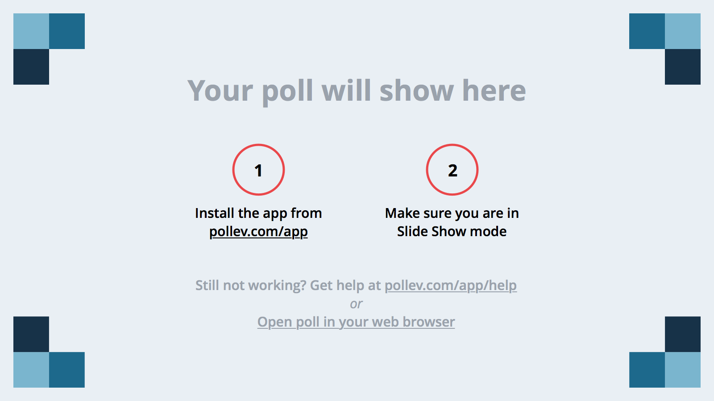
Notes:
Poll Title: How long have you been a captioner?
http://www.polleverywhere.com/multiple_choice_polls/7o6bhRd5oYfQJ1S

Slide 4
Notes:
Poll Title: How many of you have had formal training or mentoring?
http://www.polleverywhere.com/multiple_choice_polls/QyWni1hofDBXWwG

Slide 5
Why Change?
30 years educating consumers about the term “CART” – have we been successful?
Our “consumers” are changing – everybody benefits from captioning, even people without hearing loss. Baby Boomers are losing their hearing! They may not even know what to ask for
The Deaf/hard-of-hearing/disabilities community, educational and governmental entities understand “CART”; general public does not
Those in need can’t find us – Googling “CART” results in everything but Communication Access Realtime Translation! (or is it “Technology”?)
Confusion surrounding “captioning” and “CART” – only providers need to know what equipment/software is required

Slide 6
Informal Survey
The following question was posted on c2cc’s Facebook page, NCRA’s Facebook page and the Yahoo! Broadcast Captioners Forum
which pages’ members are comprised of Captioners, CART Providers,
Court Reporters, Students, and Consumers
Do you think NCRA should entertain the idea of changing the term "CART" to something which more clearly describes what it actually is?

Slide 7
Results
c2cc Facebook Results:
51 Yes
0 No
14 Maybe
NCRA CART Facebook Results:
13 Yes
0 No
8 Maybe
Yahoo! Broadcast Captioners Group Poll Results:
70 Yes
22 No
6 Maybe/Need More Information

Slide 8
Combined Results
134 Yes
22 No
28 Maybe/Need More Information

Slide 9
Should NCRA Entertain
Changing the Term “CART”?

Slide 10
Then what?
2012-2013 CART Committee discussed the survey results
Reached out to original members who created the acronym
Formed a proposal to go to the Board
The Board of Directors voted to approve the change in branding in Nashville 2013
2013-2014 the two committees discussed how to move forward

Slide 11
In the Past
captioning: text embedded with a video image via an encoder = television
CART: text on a screen

Slide 12
Now
Text on Top
Text on a PowerPoint via the Web
Text on a video
Text on a Jumbotron via an encoder
Text on a Jumbotron via an IP address
Text on a handheld device via the Internet

Slide 13

We are captioners!
There are nurses
There are lawyers

Slide 14

Christina Lewellen, MBA
Sr. Director, Marketing & Communications, NCRA

Slide 15
Captioning Matters campaign
A branded, online advocacy campaign and resource center designed to raise awareness among:
  Broadcast companies
  Content creators
  Video programming distributors
  the American public
  Other interested stakeholders

Slide 16
Captioning Matters’ Mission
  Highlight need for accurate, understandable, and timely captions
  Focus on serving both the deaf and hard-of-hearing community, as well as individuals for whom English is a second language
  “Launch pad” campaign with room for significant expansion opportunities

Slide 17
Focused goals
Captioning Matters
Advocacy
Best practices
Empower
Educate

Slide 18
Educate
Consumer-oriented website housed independently of NCRA.org
A clearinghouse with all of the latest information related to captioning:
  news
  regulatory updates
  legislative updates
  videos
  other content of interest
Best practices prominently featured

Slide 19
Best Practices
Developed by NCRA leaders in the captioning space
Allows for development of relationships
End users of captioning services
Relevant interest groups/similar organizations
Encourages support of the Captioning Matters campaign
Eventual goal: designated supporters entitled to logos and other insignia

Slide 20
Advocacy
Access to advocacy
  Grassroots efforts to acknowledge campaign
  Template letters for consumer use
  News on pending legislation/calls to action
Centralized “landing hub”
  Resource center
  Unified messaging
  Direct contact with experts

Slide 21
Empower Consumers
User profiles -- put a face on the real people who benefit from captioning services
Opportunity to tell MORE stories, in addition to the ones already there
We need YOU➔ Help secure great profiles
  Resonate with a broader user audience
  Attract the attention of the media

Slide 22
Benefits
Increased public awareness and business awareness about the needs of the deaf and hard-of-hearing
  focus on promoting captioning services.
Platform for showcasing best practices and encourage broadcasters and others to support those practices by becoming a partner or a supporting member

Slide 23
Benefits (continued)
Provides all parties seeking a broadcast captioner or CART captioner a direct link to NCRA and its experts
  positions NCRA members as leading providers of these services
  Encourage certified provider to be aware of NCRA’s Online Sourcebook options
Goal to mature the program through active involvement and partnerships with other related industry organizations and alliances

Slide 24
Next steps…
The foundation is built; time to build upon it
Beef up content:
  Advocacy resources
  Supporter concept
  Rich, diverse profiles!
Marketing push
  Greater outreach to captioners
  Alliances with similar organizations
  Media outreach

Slide 25
Notes:
Poll Title: You're standing in an elevator going to the 20th floor. Someone asks: What do you do for a living? How do you respond?
http://www.polleverywhere.com/free_text_polls/uEKgRgPhX9SsEB8

Slide 26
FAQs when booking a captioning job
When is the event?
What is the start and expected end time of event?
Will there be any concurrent sessions requiring captioning? If so, how many?
** how many writers are needed to ensure quality
What is the location of the event?
Are remote or onsite services being requested?
If remote services are required, is the venue equipped with an audio source (Skype, Google Chat/Talk, conference call system, hybrid coupler, speakerphone, or other)?
How many people will require captioning services?

Slide 27
Will the captioning be displayed for one person or the entire audience?
Will there be cameras projecting a video image? Is an encoder or character generator required for the captioning? Who will provide the encoder or character generator?
** onsite encoder captioning (data streamed through encoder or character generator and embedded onto a video image) is referred to by many names. Clarification of the type of services is needed in order to meet the customer’s expectation.
**remote encoder captioning will require phone lines at event site unless iCap is being used. If iCap is being used, Internet connectivity is required.
** CART captioning is text displayed on computer screen or may be projected on a separate screen or streamed to the Web

Slide 28
Will a Power Point or other text-based image be displayed? If so, are the captions to be displayed simultaneously via an encoder or a device such as Text on Top? Who will provide such equipment?
Is an LCD projector and screen available at the venue for the CART captioning display? If not, who will provide such equipment?
Will prep material be provided? Accuracy and quality captioning is enhanced when prep material is provided.
Will a file be provided upon conclusion of the event? If so, when and to whom?
Who will be receiving an invoice for payment and what are the payment terms?

Slide 29
HOW TO FIND INFORMATION
www.ncra.org
  Membership Tools
    Communities & Networking
      CART page or Captioning page

Slide 30
What are your COIs doing for you?
FCC Best Practices – NCRA was at the table!
CART Ethics Best Practices Task Force
Creating a Video
Plan Webinars/Convention Seminars/Write articles
Presented to HLAA – first time ever
Developing a plan to make the general public more aware of what we do
www.captioningmatters.org

Slide 31
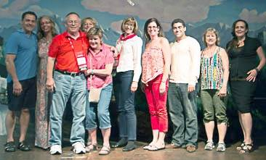
From left to right: Mike Cano, RMR, CRR, CBC, CCP; Darlene Pickard, RDR, CRR, CBC, CCP; Ray Wathen, Texas HLAA; Deanna Baker, FAPR, RMR; Lisa Richardson, RPR, CRR, CBC, CCP; Valerie Safford-Mallis, HLAA board member; Karyn Menck, RDR, CRR, CBC, CCP; Adam Finkel, assistant director, NCRA government relations; Diane Humphrey; and April Balcomb, RPR, CRR, CBC, CCP.
.

Slide 32
What does next year look like?
One Large Community of Interest
Broadcast and CART Captioning Committee
17 professionals
3 consumers

Slide 33
Heidi Thomas & Anne Bowline – board liaisons
Committee Members
2014-2015
Sandra German (Co-Chair, Broadcast Captioning)
Jana Colter (Co-Chair, CART Captioning)
Jennifer Bonfilio, Hamilton Township, NJ
Colin Cantlie, Calgary, Alberta (consumer)
Joe Gordon, New York, NY (consumer)
Patricia Graves, Monument, CO
Saba McKinley, Long Beach, CA
Carol Studenmund, Portland, Oregon
Karyn Menck, Nashville, TN
Darlene Parker, Reston, VA
Darlene Pickard, Marysville, WA
Lisa Richardson, Robbinsdale, MN
Teresa Rider, Vancouver, WA
Jane Schneider, Adell, WI
Christine Seymour, Puyallup, WA (consumer)
Sami Silvia, Honolulu, HI
Mary Beth Simpkins, Tucson, AZ

Slide 34

Thank you to our departing
committee members!
Steve Clark
Melissa Gum
Jen Schuck
Tammy Milcowitz
Lise Hamlin
Tracy Reinke

Slide 35
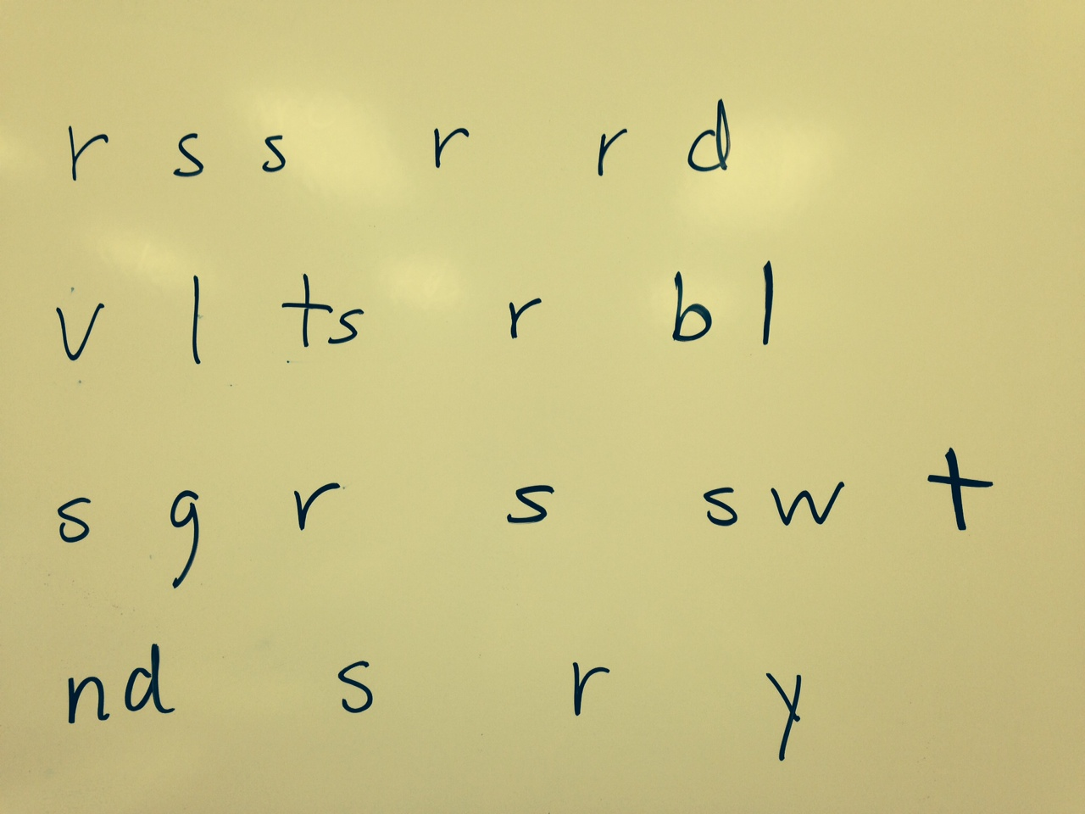
Remember The Consumer!
348 of CCPs
321 CBCs
3% of Membership
Growing every day
Educate going forward

Slide 36
Notes:
Poll Title: What would you like NCRA to do in the future to support captioners?
http://www.polleverywhere.com/free_text_polls/ZGxje5eUnfc4ars

Slide 37
It is not the strongest of the species that survive, nor the most intelligent, but the one most responsive to change
-- Charles Darwin

