Slide 1
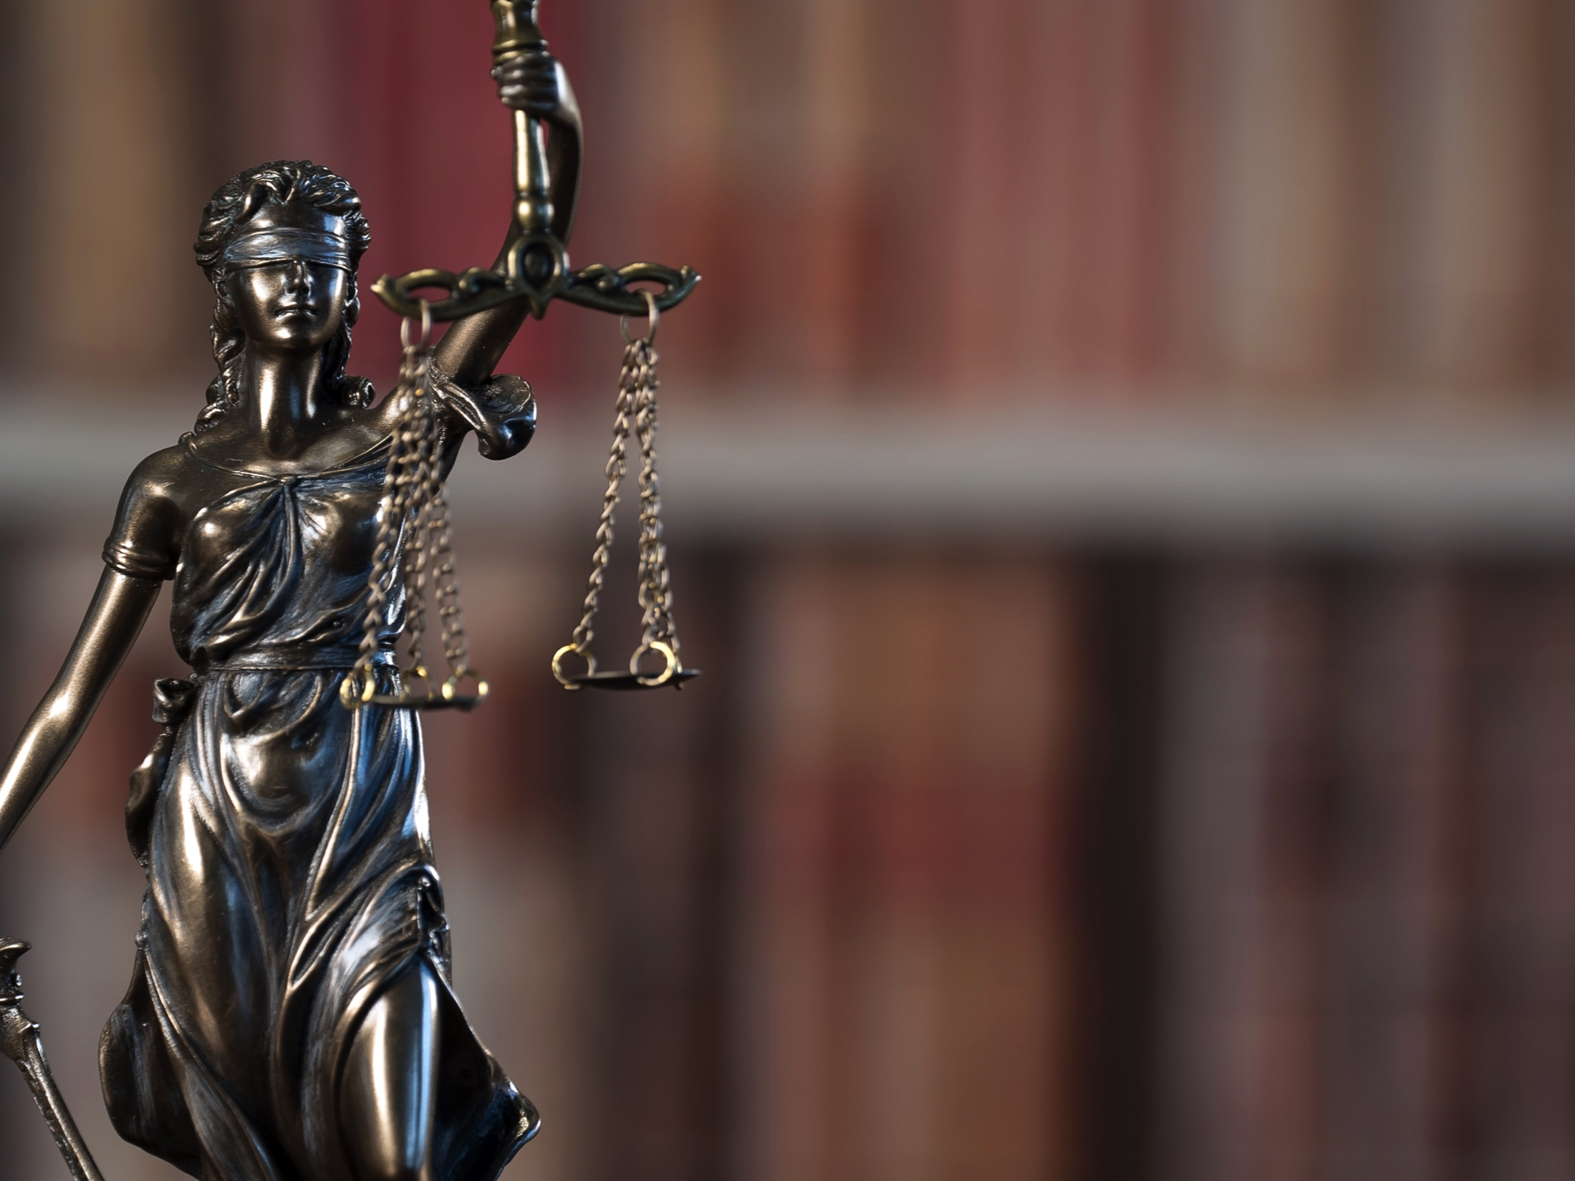
Making the
Best Record
Customized text area
Name of presenter
Contact information
Created by

Slide 2

Why should you give a presentation about making the record?
Who better than a reporter to explain the magic that we do.
You are the expert.
Notes:
Have the audience give their reasons.
If fear of failure is mentioned – tell story of how you overcame such a fear.
Why magic? Get them to buy into how remarkable what we do is. .0001 percent of the world can do what we do. When we are “selling” out profession – we need to sell it so as to instill awe in out end users as to what we are capable of doing.

Slide 3
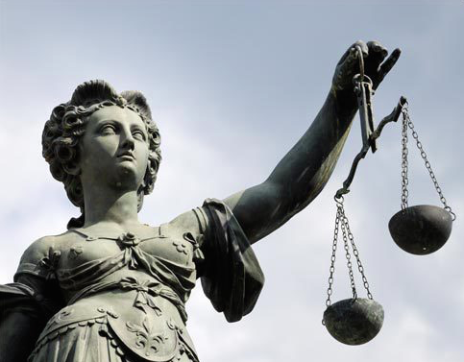
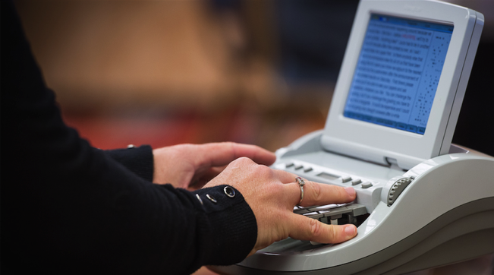

The attorney’s job is to
make the record.
The stenographic court reporter’s job is to preserve it.
Notes:
The court reporter’s role is to capture and preserve the record:
In the courtroom
In deposition proceedings
In any setting where an accurate record needs to be made
We preserve the record for posterity and appeals.

Slide 4

Stenographic court reporters
  are independent officers of the court
  serve all parties and have no interest in the outcome of the proceedings

Slide 5

Stenographic court reporters
who are members of NCRA
must adhere to a Code of Ethics
Ethics
Integrity

Slide 6

Points to remember …
Notes:
Especially outside of the courtroom, attorneys need to remember:
The role of the freelance reporter is the same as the judge’s reporter in court.
We are the court reporters making the official record. We are working for all parties present.
Never ask a court reporter in a deposition to do something that you would not ask the judge’s court reporter to do … in front of the judge.
This is important because the reporter will not compromise his or her ethics.

Slide 7
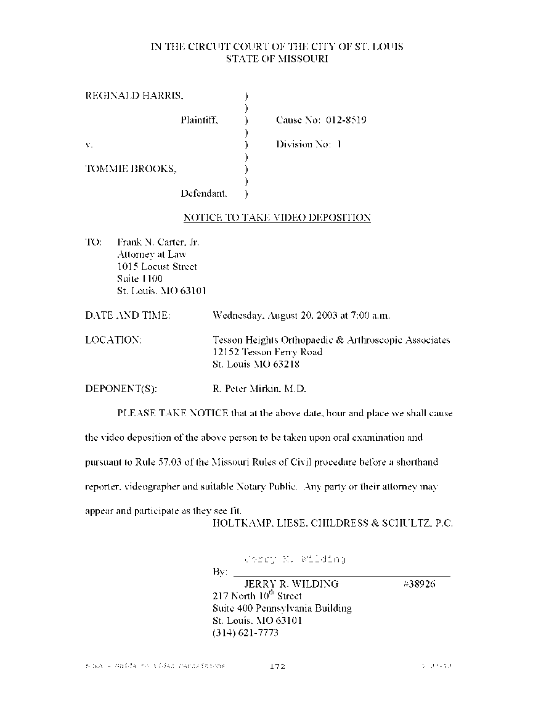
Making the best deposition
record starts at scheduling!
  notice of taking deposition that specifies it is to be taken by stenographic means
  estimated duration
  special reporting needs
  special technology needs
  videographer?
  interpreter?
Notes:
Here are important things we will need upon scheduling:
A Notice of Taking Deposition
This helps us ensure we have the case information, names of parties, filing numbers, and (hopefully) correct spellings of all involved.
How long do you anticipate the proceedings to last?
This helps us properly schedule a reporter with that availability.
Some proceedings may require two reporters (i.e., starting at 8 a.m. and going into the evening until completion).
Special needs
Will you need:
A realtime reporter?
A videographer?
A rough draft?
An interpreter: Sign language interpreter or spoken language interpreter?
A sign language interpreter would be for communication access. The spoken language interpreter would be for one spoken language simultaneously to another … or it could be consecutively done as well.
If receiving realtime, will you need us to provide loaner laptops/tablets? Will you want to stream the realtime to other parties not present?

Slide 8

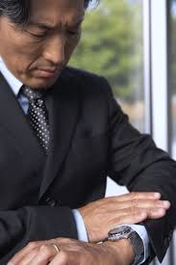
More things to consider
when scheduling!
  When do you need the transcript?
  What transcript formats do you prefer?
  Advise ASAP if the deposition cancels.
Notes:
Delivery
Ask the reporter what his or her standard delivery is, and let him or her know if you think you may need it sooner. Remember this will trigger an expedited charge.
If the deposition is held on Monday, calling the court reporter on Thursday afternoon to say you need it on Friday may result in an overnight expedited fee if the court reporter has not yet begun transcribing your deposition. Planning ahead and alerting the reporter prevents this from happening. Plus, not arranging expedite in advance may result in the reporter not being able to do an on-demand expedite in addition to other expedites he or she is juggling.
Transcript format
Do you want the transcript emailed? Would you like paper? Standard size transcript, condensed, or both? These are a few of the questions you will be asked by the court reporter when ordering a transcript.
To avoid late-cancellation fees, be sure to advise the court reporter as soon as a deposition cancels.

Slide 9
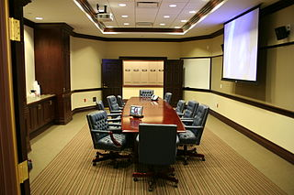
Before asking your first question in a deposition …
  consider room layout and acoustics
  locate a place to see and hear adequately
  prepare exhibits to pre-mark
  provide your business card
  inform your witness of reporter’s role
Notes:
In a deposition:
Consider the room dynamics. The court reporter needs to hear the testimony, so he or she will want to be as close as possible to the witness and questioning attorney.
Allowances may need to be made for ambient noise, such as loud fans, traffic, papers shuffling.
Allow the reporter to select the location in the room that enables the reporter to make the best record possible.
Both in a deposition and in the courtroom:
Introduce yourself to the reporter, tell the reporter who you represent, and give the reporter (and videographer) your business card.
If you have any exhibits that you know you will be introducing, you can have the reporter pre-mark them so they are ready when you want to introduce them … or the reporter can mark them in real time as needed. Always let the reporter mark the exhibits so that there is a record of which number/letter is to be used next to avoid duplication or getting out of order.
Let the witness know what the reporter’s role is and advise the witness that he or she needs to answer audibly in order for the court reporter to take down the testimony accurately.

Slide 10
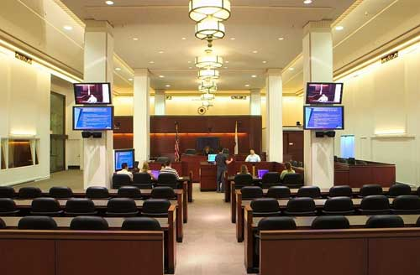
In a courtroom …
    do not turn your back to the reporter
    the judge determines all other protocols, and the reporter can assist you with that information
Notes:
Courtroom layouts differ, so when making a record in a courtroom, attorneys should still be aware of acoustics/microphones/turning your back to the reporter.
In terms of marking exhibits and instructing the witness, those protocols are determined by the judge. The official reporter can give guidance on such things as marking the exhibits and other courtroom procedures.

Slide 11

The goal:
To capture every word!
  Enunciate clearly.
  Speak at a
  well-modulated pace.
  Refrain from interrupting.
  Suspend question/answer while reporter is marking exhibits.
Notes:
Now that you’re ready to start making your record, here are best practices to ensure all words are captured by the reporter.
If you learn but one rule, this is a very good one. Learn not to interrupt! Don’t interrupt the witness’s answer or counsels’ objections. Allow everyone to finish speaking before you begin. It only counts if it’s in the record, and the reporter can only capture one voice speaking at a time.
It’s very common to hand a document to the court reporter to mark and then begin speaking. The reporter can only perform one task at a time.
If requested to repeat what you said, just repeat it rather than including “I said…”

Slide 12

More best practices
  Be mindful when reading.
  Be precise with numbers.
  Spell case-specific proper nouns for the court reporter.
  Please spell slowly.
Notes:
Be mindful when reading! Most people read things into the record at a much quicker pace than they speak.
The reader will be given more latitude if the reporter will have possession of the exhibit. If the reporter will not get the document – and the reader is speaking at a rapid pace – the reporter will interrupt as needed to capture the testimony verbatim.
Numbers can be tricky. When referring to money, make sure you use the words “one thousand two hundred and fifty dollars” and not just “twelve fifty.” Also, some numbers sound alike (e.g. 16 and 60). If counsel does not enunciate clearly, it’s hard to decipher which number is correct.
The reporter is often the only person in the room who isn’t familiar with the case, so it’s very helpful to proactively spell case-specific proper names and terminologies.
It’s really helpful if you provide spellings that the reporter will not know beforehand whenever possible, or right at the time they are introduced into the record.
The reporter may ask you on a break or at the end of the proceedings or even at some point thereafter to assist with spellings that he or she was unable to find or verify.

Slide 13

  Reporters write
  what is being said,
  not what is being done.
Notes:
When making your record, remember that a court reporter cannot take down or interpret gestures.
So, if a witness points, the record will reflect “witness indicating,” not at what the witness is pointing. It is up to the attorney to clarify when a witness is gesturing.
Clarify by using such descriptives as “You are pointing to the upper right-hand corner of the exhibit” or “You have just indicated the front passenger tire; correct?”

Slide 14
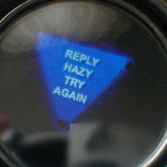
Clarify
“uh-huhs,” “uh-uhs,”
“mm-hms,” and “mm-mms.”
Notes:
The most common mistake made when making the record is allowing a witness to repeatedly use utterances such as “uh-huh” in place of “yes.”
Despite cautioning the witness at the start of the record, most people will revert to “uh-huhs” quickly, and many attorneys fail to realize this until they receive the transcript.
For a very important answer, “uh-huh” may not be sufficient.

Slide 15
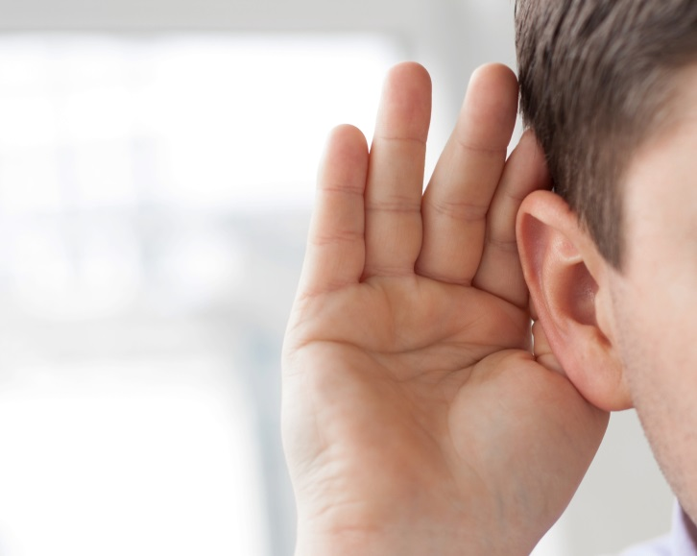
  Did you say…
  “B”? “C”? “D”?
  “V” or “3”?
  “A” or “The”?
Notes:
Many things sound the same when the speaker is not enunciating, when the reporter is unfamiliar with the context, or when ambient noises make it difficult to hear.
Be sure to clarify, especially acronyms.

Slide 16

Things to avoid:
  uttering “okay,” “I see,” and “all right”
  using double negatives
  using vague pronouns
  creating distractions such as clicking pens
  going for long periods without stopping for a break
Notes:
Avoid starting each question with an expression such as “all right,” “okay,” or “I see.”
Remember, two negatives make a positive! “So, he didn’t say he wouldn’t do that?”
Clarify pronouns: Respond to “he pointed the gun at her” by saying, “So John Smith pointed the gun at Mary Jones; correct?”
Sounds such as clicking or tapping a pen repeatedly, jingling coins, clearing your throat, or coughing can be very distracting.
It is recommended that you break every 1.5 to 2 hours. The later in the day, the more frequently the reporter will need a break to stretch.

Slide 17

Be very careful
  State you are going on or off the record.
  Say when a quote begins and ends.
  Indicate what is and isn’t confidential or “attorneys’ eyes only.”
  Use an appropriate level of vocabulary so that the witness understands you.
  Clarify thick accents.
  Refrain from saying “here” or “there” (use directions such as “east” and “west”).
Notes:
Many attorneys forget to indicate that they are going back on the record after having gone off the record.
Be sure to use the words “quote” and “unquote” to designate when a direct quote begins and ends.
Be mindful of confidential portions of the transcript and when “attorneys’ eyes only” begins and ends.
If you’re questioning a witness without education, refrain from using words such as “subsequently,” “equidistant,” and “vis-a-vis” in your questioning.
If you can’t understand the witness, chances are the court reporter can’t either. Clarify or ask people with accents to repeat their answer if you have difficulty hearing and understanding them.
Many witnesses confuse directions. You may be better served asking, “So you were traveling towards downtown” than “So you were traveling west when the accident happened.”

Slide 18

At the deposition:
  If applicable, ascertain whether the witness would like to
  read and sign.
Notes:
Statutes on the right to read and sign off on the accuracy of the court reporter’s transcript vary from state to state. If state rules provide for this, be sure to advise the witness of his or her right and capture on the record whether he or she preserves the right or waives it.

Slide 19

To obtain your transcript:
  be sure to indicate a date needed
  know court reporter lingo:
    condensed, full-size
    pdf format, e-transcript
    linked exhibits, synched video
Notes:
Let the reporter know when and in what formats you would like your transcript delivered.
Clarify what the reporter’s normal delivery time is.
Let the reporter know if you would like to receive a rough draft, an electronic copy only, an electronic copy along with a printed copy, printed copy only, copies of exhibits, exhibits electronically linked in the transcript, etc.

Slide 20

Often, time is of the essence.
  Please be responsive when the reporter contacts you for clarifications, as this could affect timeliness of transcript delivery.

Slide 21






As with attorneys, stenographic court reporters have different levels of experience and expertise.
Notes:
(The presenter can expound on this as he or she sees fit.)
Pay attention to court reporters’ business cards and websites. The initials stand for various levels of expertise and competency. Just as attorneys can become trial-certified with further testing, so, too, can reporters become further certified depending on their speed, accuracy, and knowledge base.
Not all states require certification, which makes this even more important. Do you want a court reporter who voluntarily becomes certified through testing, or someone who only fills out paperwork to become a notary public?
Because court reporters do not charge more for additional expertise, it is particularly advantageous for attorneys to pay attention to the initials that court reporters have after their name.
A rule of thumb you can live by is: More is definitely better.

Slide 22
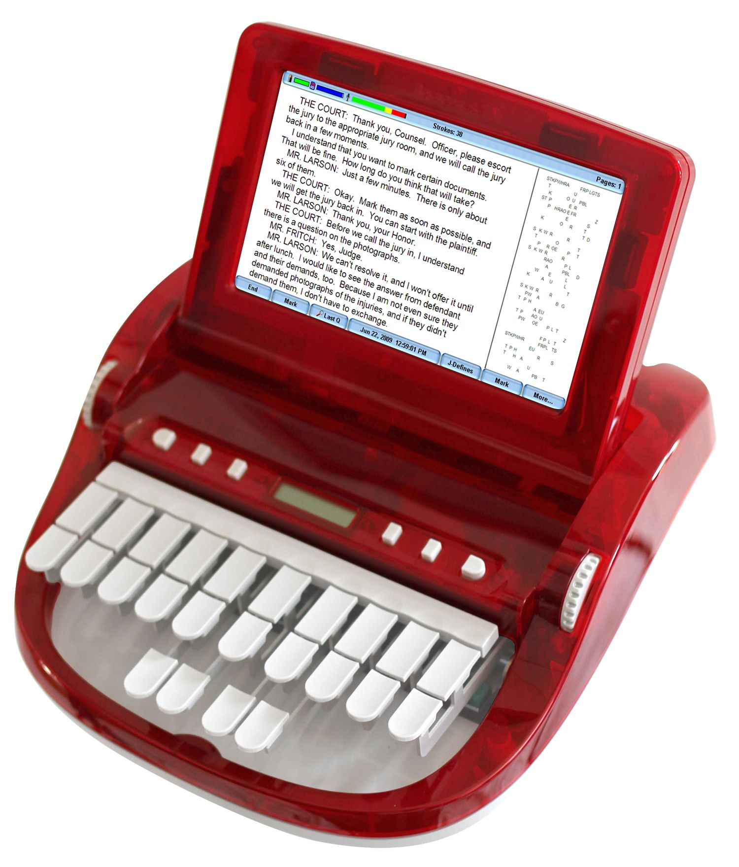
Stenographic court reporters:
The Gold Standard
Stenographic court reporters clarify the record, securely prepare certified transcripts, have no “inaudibles,” and properly identify speakers.
Stenographic court reporter transcripts are guaranteed to be properly certified and admissible.
Notes:
The education, training, and ethics followed by an NCRA- or state-certified stenographic reporter are far superior, and they meet legal requirements for the making of a record. The only requirement for digital recorders is a few hours of training and becoming a notary public.
Indicate in your notice of deposition that it will be taken before a stenographic court reporter.
You may be offered the alternative of, or be asked to stipulate to, the use of a digital recording in lieu of a stenographic reporter. Beware that agreeing to stipulate away requirements mandated by rules of procedure may render your transcript inadmissible.

Slide 23

As with attorneys and stenographic court reporters, videographers also have different levels of experience and expertise.

Slide 24

To get the most out of your stenographic court reporter, get to know the services he or she can offer!
Notes:
Court reporting technologies have greatly advanced over the years! We can now stream testimony and proceedings not just across the table but across the world … and not just to computers but to laptops, tablets … even smartphones!

Slide 25

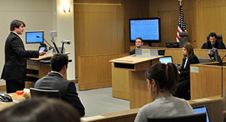
Court reporters can
offer assistance in trial presentation.
Notes:
While not every case or deposition requires today’s latest technologies, leveraging state-of-the-art offerings from your court reporter can create an advantage over your opponent by keeping your audience fully engaged and visually demonstrating difficult concepts.
Clarify that it is freelance reporters who offer services such as exhibit organization (archival and retrieval, especially in complex litigation) and other litigation support services specifically for presentation at trial.
More on this on a later slide …

Slide 26
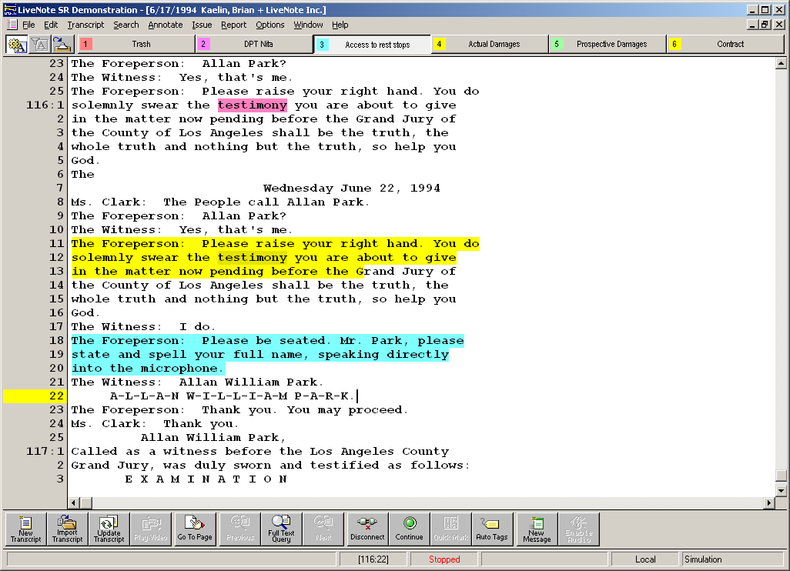
Advantages of realtime technology
  live feed from
  court reporter
  case-specific highlights
  flagging of
  key words
  makes review EASY
Realtime transcript feed display
Notes:
Using realtime technology provides many key advantages:
The high-tech look of realtime oftentimes creates an intimidating advantage over opponents.
Answers can be reviewed as many times as necessary ... without asking the court reporter to read back.
Realtime software for attorneys provides for flagging key words, highlighting key issues, and marking the transcript for easy searchability later.
There is tremendous power to having the record live on your laptop or tablet:
As opposed to flipping through a paper note pad looking for key notes, word search the transcript electronically for near instantaneous results.
Avoid being challenged by a witness telling you, “That’s not what I said,” as can happen when paraphrasing testimony off notes on your paper pad. Quoting directly from the official record puts an end to those challenges.
Particularly important when examining expert witnesses.
Special note – The more information a reporter receives as far as proper nouns, witness names, terminology – the better the realtime stream will be.

Slide 27
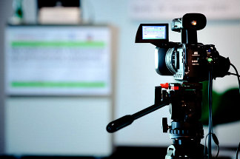
Additional services available:
  videotaping of depositions
  synchronizing video
  to transcripts
  paperless exhibits
  exhibits linked within
  electronic transcript
  mobile videoconferencing
  trial technologies
  CART for people who are deaf and hard of hearing
  interpreter services
Notes:
This slide can be amended or completely deleted, depending on who is giving this presentation and to whom. It is intended to represent the latest offerings most court reporters can provide to attorneys. The presenter should be able to explain what each does within his or her own knowledge base and comfort level.

Slide 28
Using realtime captions
in the judicial setting
  Assess the needs of the person requiring the service.
  Give adequate notice to court administration that CART will be needed.
  Provide detailed information to the reporter to prepare.
  Allow adequate time for the person to
  read the screen.
Notes:
The CART/captioner works for the individual person who is deaf/hard-of-hearing and also captions conversations with his or her counsel, which no one else should have access to. There’s strict codes for separating the functions of court reporter and CART/captioner.
Ask a person with hearing loss what their preferred mode of communication is in a judicial setting.
The more we can “front” load into our dictionary, the better the transcription rate.
The normal pace will not allow the person time to read and “digest” what is displaying on the screen. Be aware that extra time will be needed before the person is able to respond.

Slide 29

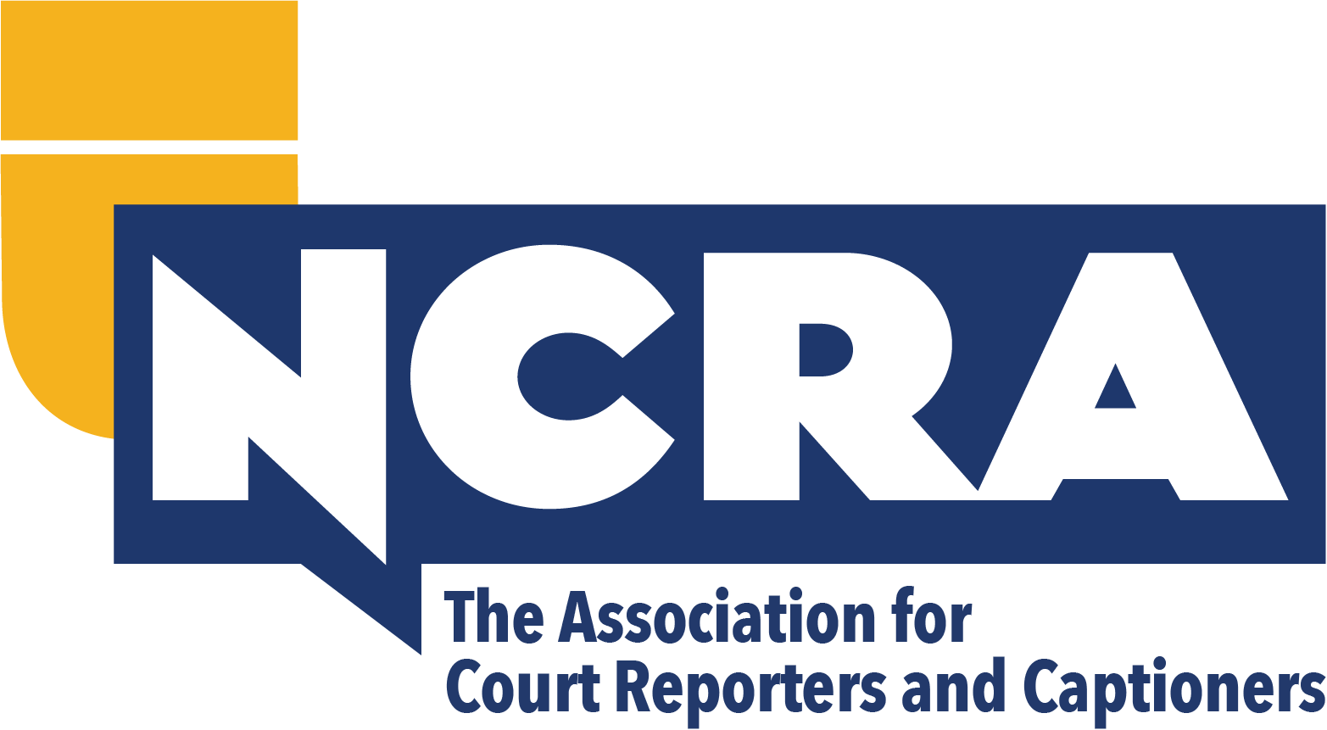
Questions?
For a copy of this presentation, visit
^{NCRA.org/LegalEd.}
This information was created for the National Court Reporters Foundation’s (NCRF) Legal Education Program as an educational tool. It may not be duplicated or used for financial gain or any use other than education.
May2022
107-2

